Slide 1
Mental Health Survey Program
A C++ Program for Collecting and Analyzing Mental Health Data
Presented by : Techburners

Slide 2
introduction
• Purpose of the Program:
- To assess mental health by collecting responses on mood, stress, sleep, and self-care.
- To provide simple feedback and recommendations based on user responses.
• Technology Used: C++ (File Handling & User Input)

Slide 3
Class Structure
• Class: MentalHealthSurvey - conductSurvey(): Manages the survey and writes to a file. - Private Methods: - askGeneralMoodQuestions() - askStressAndAnxietyQuestions() - askSleepAndRestQuestions() - askPhysicalActivityQuestions() • Main Function (main())

Slide 4
Engaging the audience
User Input and File Handling:
The program saves responses to survey_results.txt.
Questionnaire Covers:
Mood & Stress
Sleep Quality
Physical Activity & Self-Care
Automated Feedback:
Provides recommendations based on answers.

Slide 5
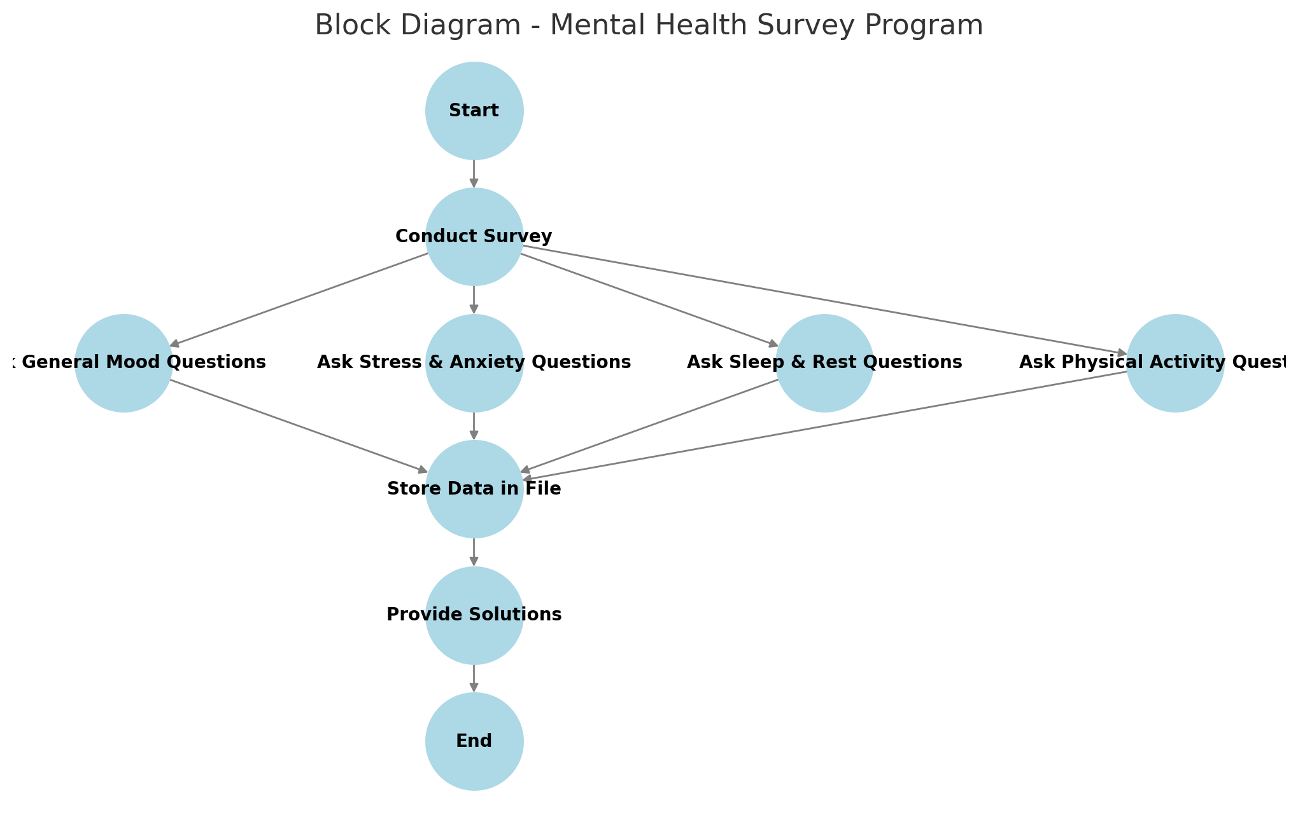
Block diagram:

Slide 6

Future Improvements
Enhancements to Consider:
Error Handling: Validate inputs.
Menu-Based Navigation: Allow users to select sections.
Graphical UI: Convert into a web or app-based system.
Detailed Analysis: Offer personalized suggestions based on trends.

Slide 7
conclusion
The Mental Health Survey Program provides an interactive and structured approach to assessing mental well-being. It collects user responses on key aspects such as general mood, stress and anxiety, sleep quality, and self-care habits. Based on the input, it offers personalized suggestions to help improve mental health.

